Slide 1
Refactoring to Cleaner Code
with Jay Bazuzi
& @LlewellynFalco

Slide 2
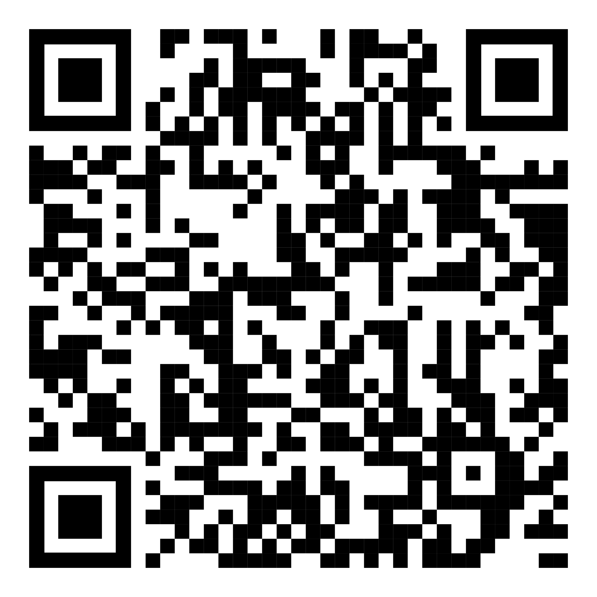
Resources
https://github.com/isidore/Talks/
blob/master/RefactoringToCleanerCode.md

Slide 3
Mob Programming

Slide 4
Why we Refactor?
Change
Change what the code does
Change how you use code
Insights
Record an insight
Gain an insight

Slide 5
Better Games
We work at an online game company that wants to improve the BigDiceGame experience.
Our product owner ‘has a few ideas’ and we want to make the code flexible to try things out

Slide 6
Some possible ideas…
Simpler
Maybe there are too many different options already
New Scores
Add scoring for Straight and 3 of a kind. Maybe some others
Different Levels
Easy, Normal, Expert versions with subsets of the rules

Slide 7
Let’s Refactor!

Slide 8
Some possible ideas…
Simpler
Maybe there are too many different options already
New Scores
Add scoring for Straight and 3 of a kind. Maybe some others
Different Levels
Easy, Normal, Expert versions with subsets of the rules

Slide 9
Pop Quiz! What does FiveOfAKindCalculator Do?

Slide 10
Instead of extending the system to add your feature,
extend it to add extendibility
and then plug in your feature

Slide 11
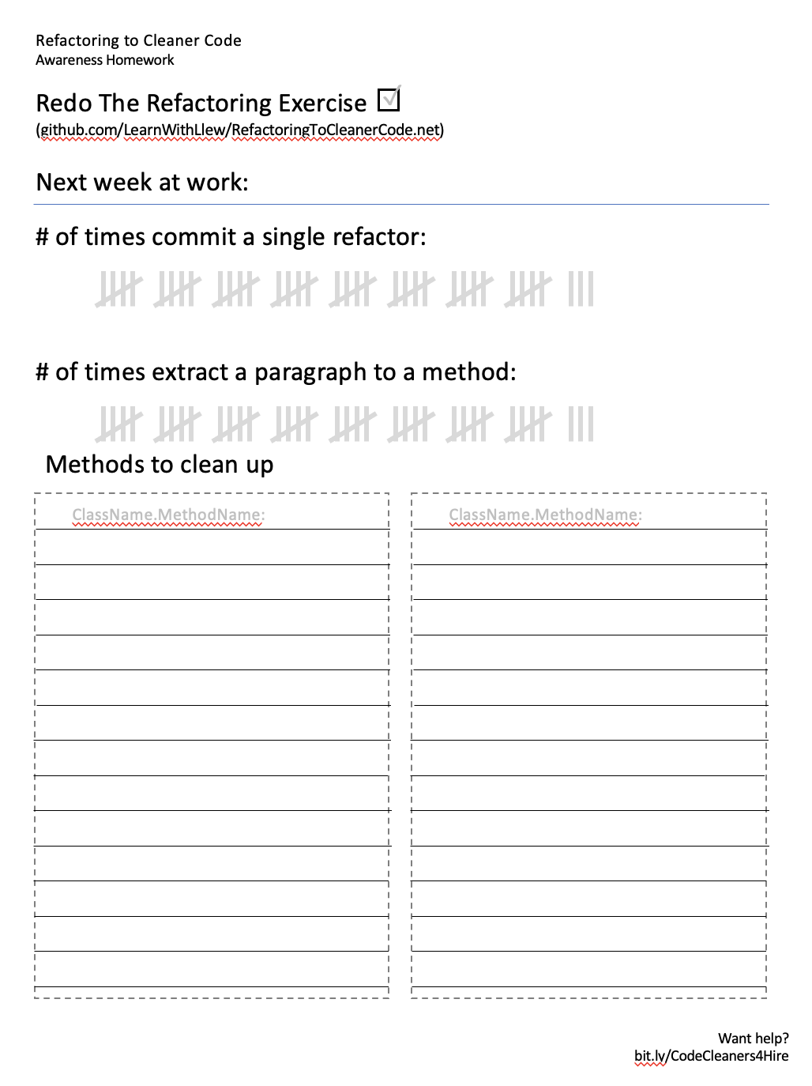
Homework
Making these behaviors stick

Slide 12
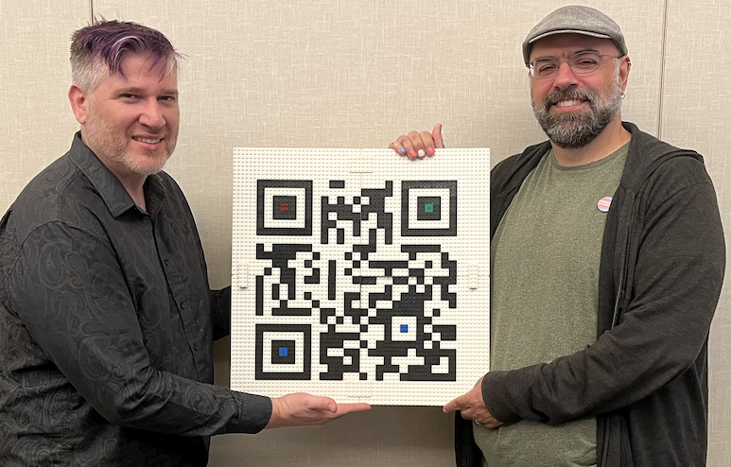
Resources

Slide 13
Resources
https://github.com/isidore/Talks/
blob/master/RefactoringToCleanerCode.md

Slide 14
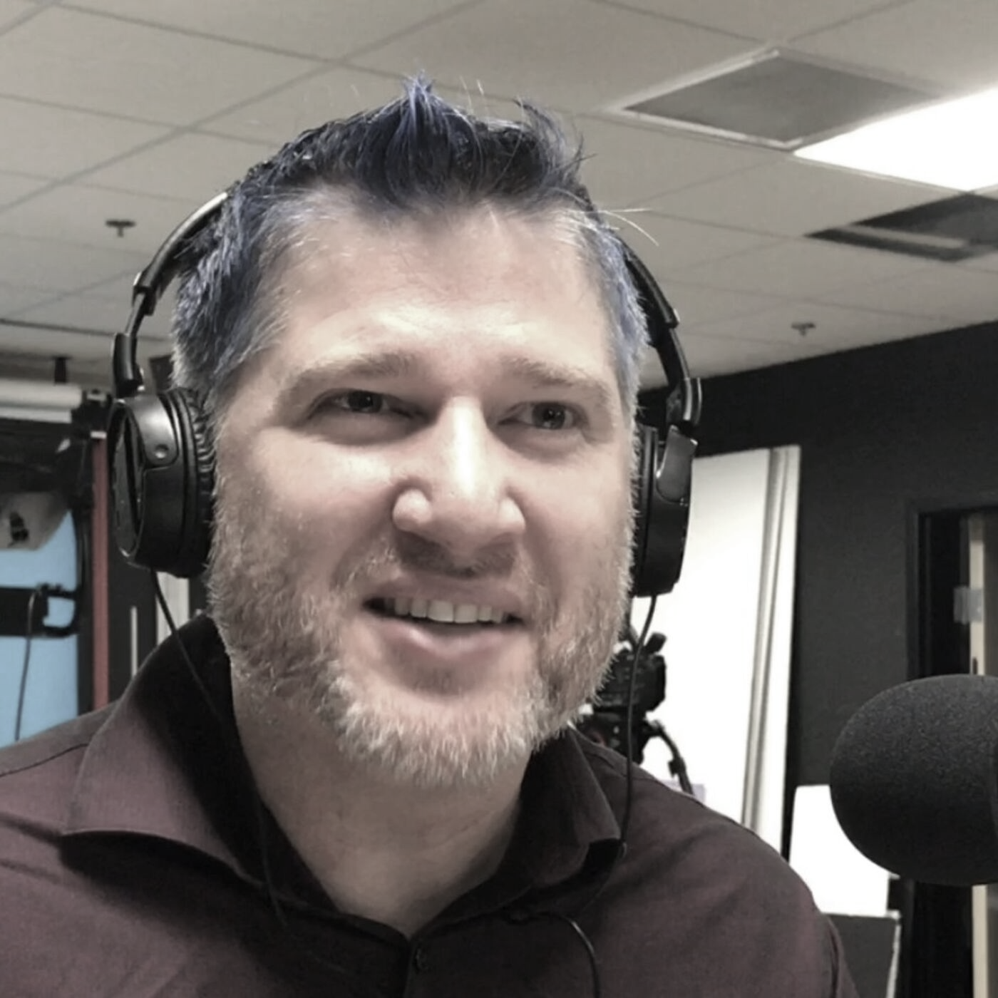

thanks!
Any questions?
Please connect through LinkedIn
@LlewellynFalco
Llewellyn.Falco@gmail.com
@JayBazuzi@mastodon.online
jay@bazuzi.com
Presentation template by SlidesCarnival

